Slide 1
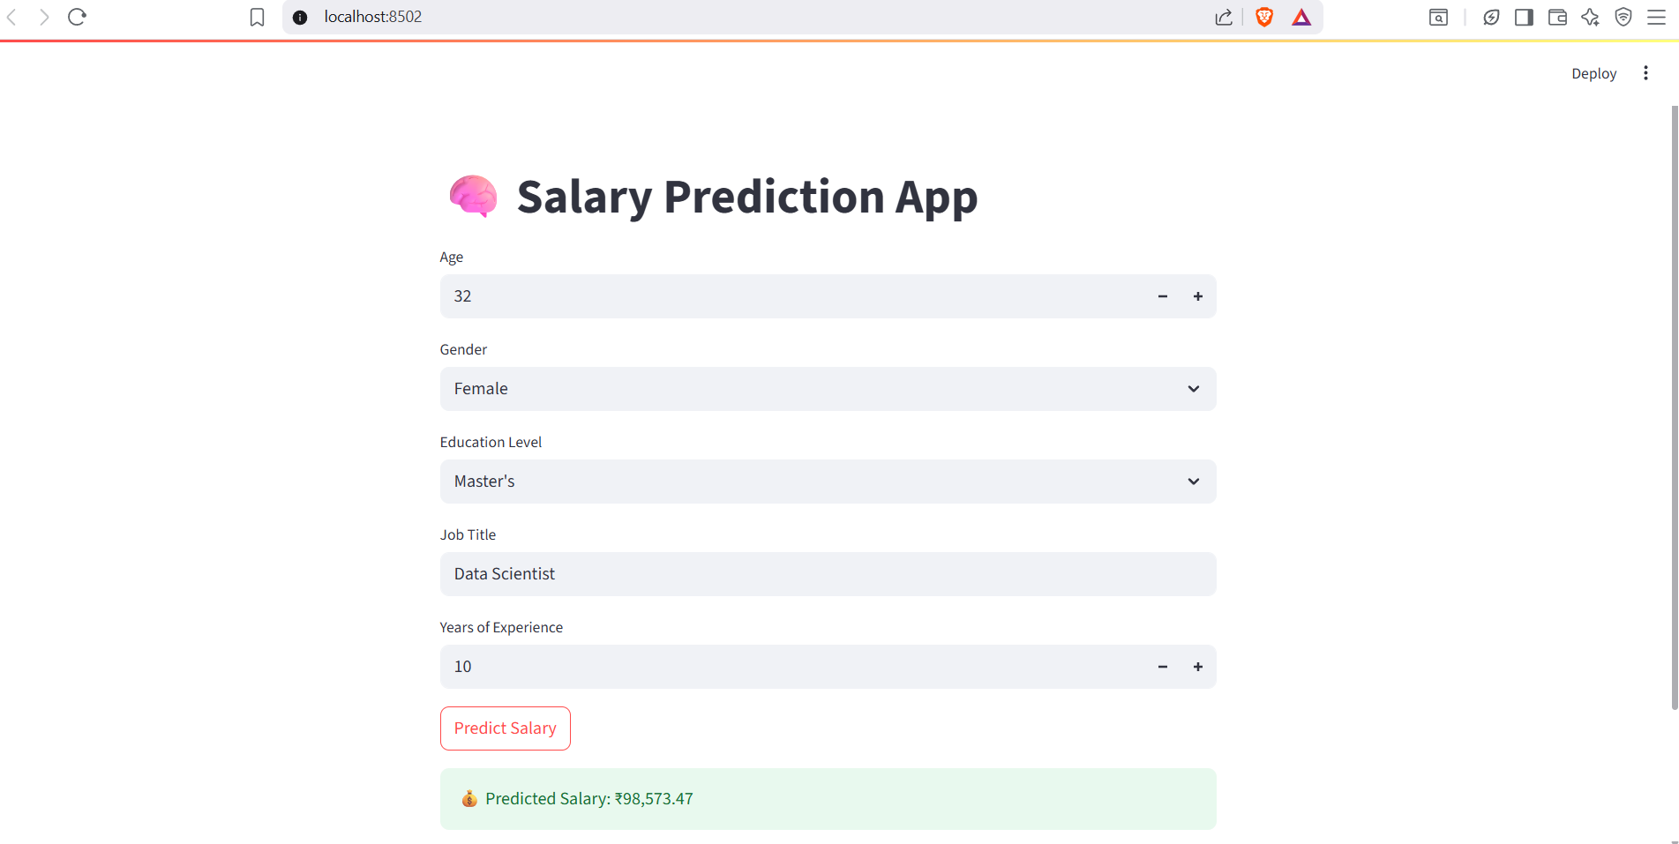
Salary Prediction Using Ensemble Learning
Streamlit | scikit-learn | GitHub
By-Anshika Dwivedi

Slide 2
🔍 Project Overview
Predict salaries using machine learning ensemble models.
Built with Python, scikit-learn, and Streamlit.
Dataset sourced from Kaggle.
User-friendly prediction interface powered by Streamlit.

Slide 3
🛠 Tech Stack
• Python – Core programming
• Pandas – Data manipulation
• scikit-learn – Machine learning
• Streamlit – Web app interface
• Pickle – Model serialization
• GitHub – Version control

Slide 4
📁 Project Structure
C:/python/env1/
├── app.py → Streamlit web app
├── salary_model.pkl → Trained ML model
├── model_columns.pkl → Feature columns for prediction
├── requirements.txt → Project dependencies
├── README.md → Documentation
├── LICENSE → MIT License
└── dataset.csv → Optional dataset

Slide 5
📂 Dataset
Source: Kaggle
Link: https://www.kaggle.com/datasets/rkiattisak/salaly-prediction-for-beginer
Includes features:
• Age
• Gender
• Education
• Job Title
• Year of Salary
• Salary

Slide 6
📊 Model Details
• Random Forest Regressor – Ensemble of decision trees.
• Voting Regressor – Averages predictions from multiple models.
• Trained with encoded categorical features.

Slide 7
🧪 Sample Prediction
Education: Master’s Degree
Experience: 5 Years
Job Title: Data Scientist
Employment Type: Full-time
→ Predicted Salary: ₹12,50,000 annually

Slide 8
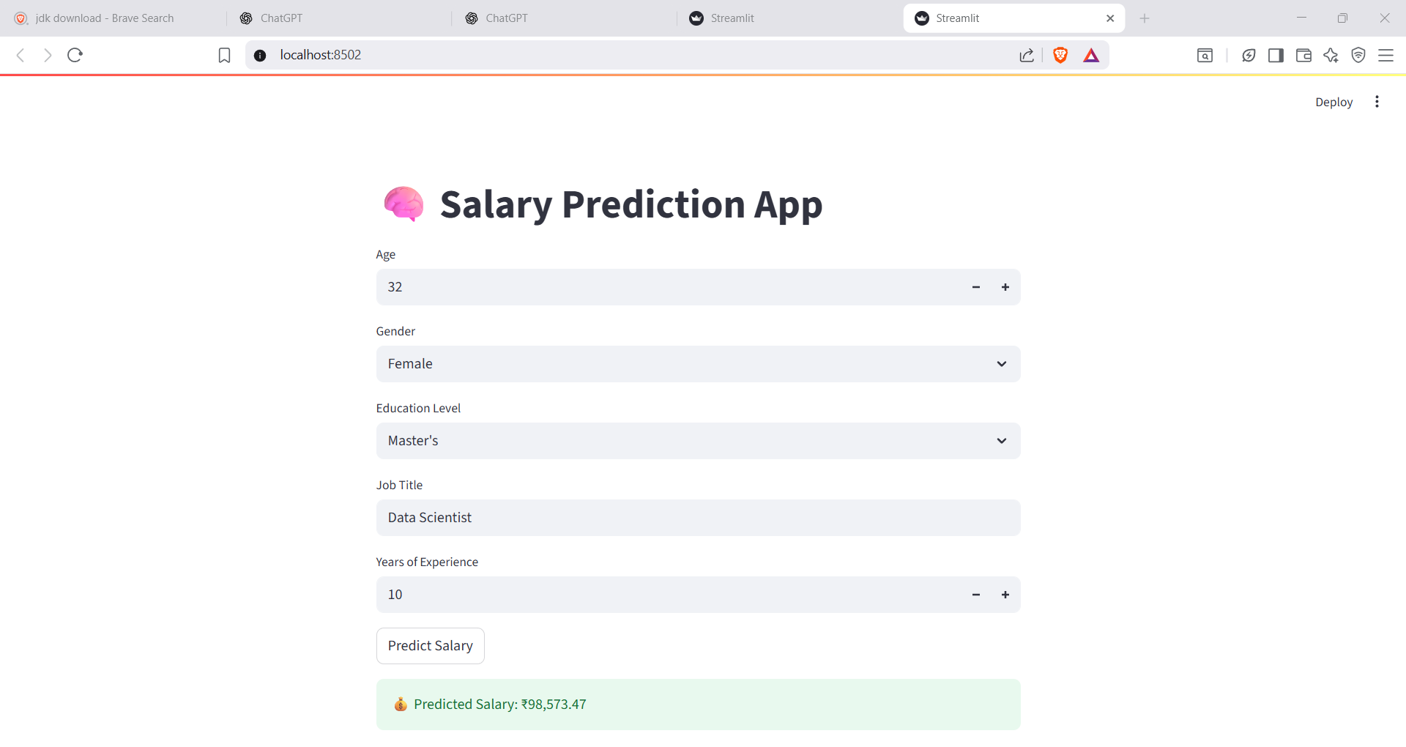
OUTPUT

Slide 9
🚀 How to Run the App
1. Open terminal and navigate to project folder.
2. Create and activate virtual environment.
3. Install dependencies: pip install -r requirements.txt
4. Run the app: streamlit run app.py
5. Open browser and go to: http://localhost:8501

Slide 10
License & Acknowledgements
• License: MIT License
• Dataset from Kaggle
• Built using Streamlit and scikit-learn

